Slide 1
Mass migration of records:
LRM-Factory, a solution to facilitate the migration to linked data for bibliographic agencies
Lrm-factory project
25/09/2025
Marie BASTIEN, Morgane SEDOUD - DOCUMENTATION CENTRALE - DIR. DES AFFAIRES GÉNÉRALES ET DE LA COMMUNICATION

Slide 2
Lrm-factory project

Slide 3
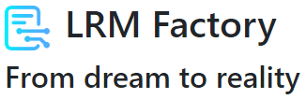
Lrm-factory project
LRM-Factory : the first metadata factory to facilitate the transition to the semantic web or bibiographic agencies ; enables mass migration of collections

Slide 4




Lrm-factory project
Piloted by:
ACASE consortium
Access to Arts, Culture and Sciences Through Entities
Owners and developpers of the project’s interfaces:
Documentation experts developping rules sets, studying and publishing mappings, in charge of the project’s valorization.

Slide 5
com3T: a pattern level migration tool

Slide 6
com3T: a pattern level migration tool
Oriented graph of bibliographic patterns as a meta-model of rules
Recognition of patterns
Input and output vocabularies configured as external files: the factory can be used with any format (example: RDA, BIBFRAME, RDA-FR)

Slide 7
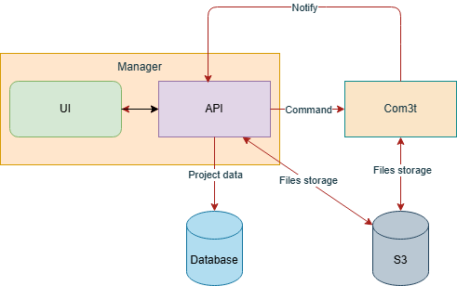
com3T: a pattern level migration tool
Representation of the technical architecture of LRM-Factory

Slide 8
Conversion and bibliographical patterns

Slide 9



Conversion and bibliographical patterns
30 months projects
Conversion of records from the sudoc Abes (Higher Education bibliographical agency)
Mapping UNIMARC to RDA
No pre-existing mapping UNIMARC to RDA
UNIMARC

Slide 10
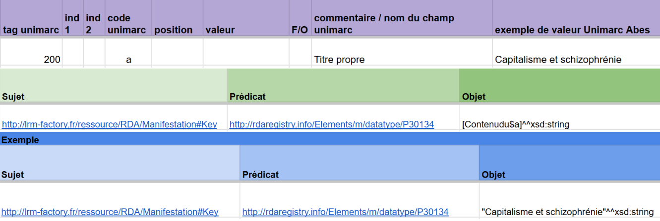
Conversion and bibliographical patterns
Mapping rules in triplets
Starting point of all conversions

Slide 11


Conversion and bibliographical patterns
Conversion organized in sprints
Deduplication process for all records handled during conversion
Validation after each sprints:
Produced from our mapping table, controls RDF files compliance
Direct view on patterns, data comparison between sprints with SPARQL queries
Data control in the perspective of a library catalog

Slide 12
Tool demonstration

Slide 13
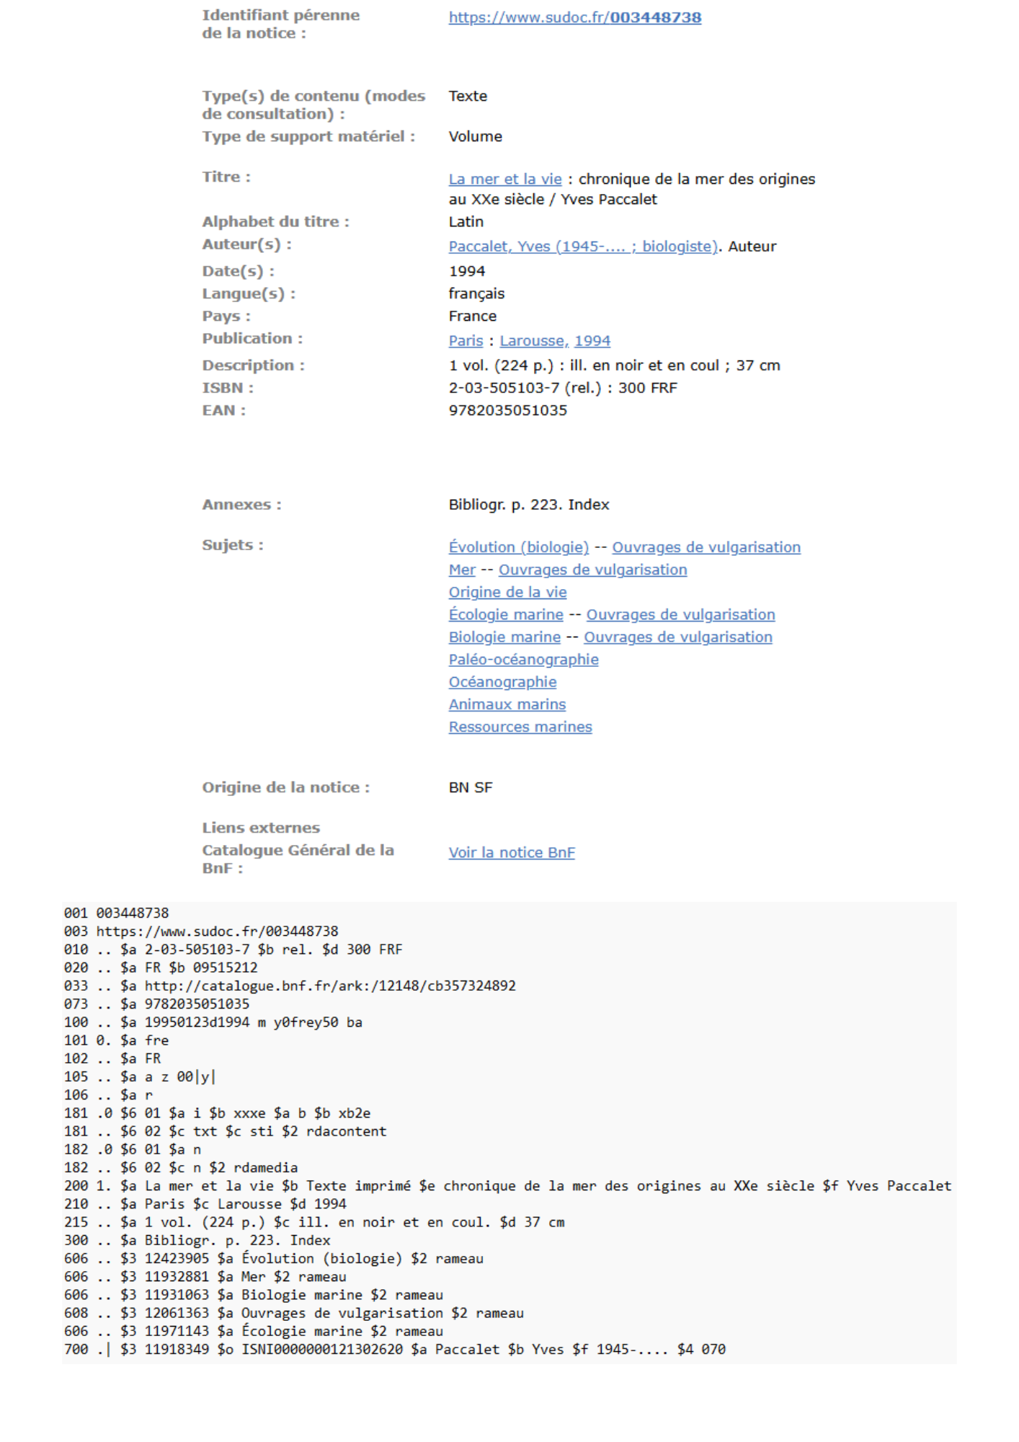
Tool demonstration
Chosen record
Monograph titled « La mer et la vie » by Yves Paccalet

Slide 14
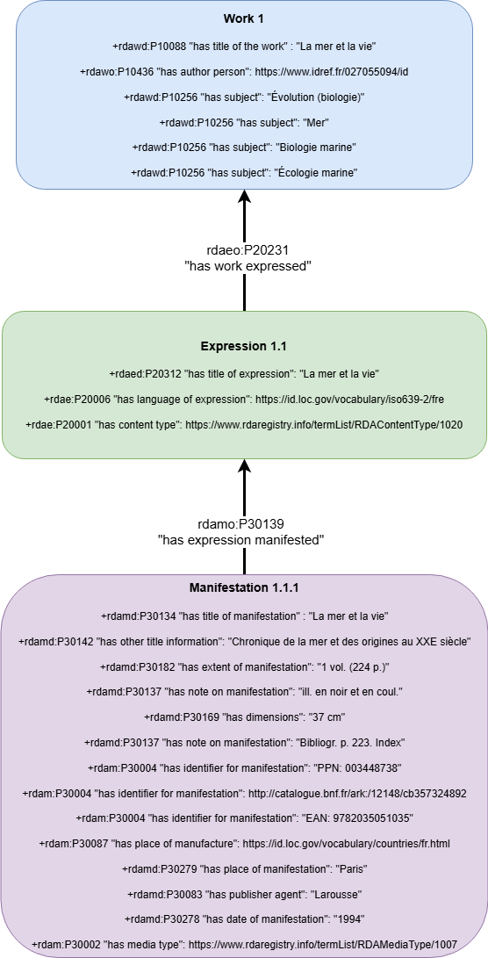
Tool demonstration
Chosen record
Modeled in a simple tree

Slide 15
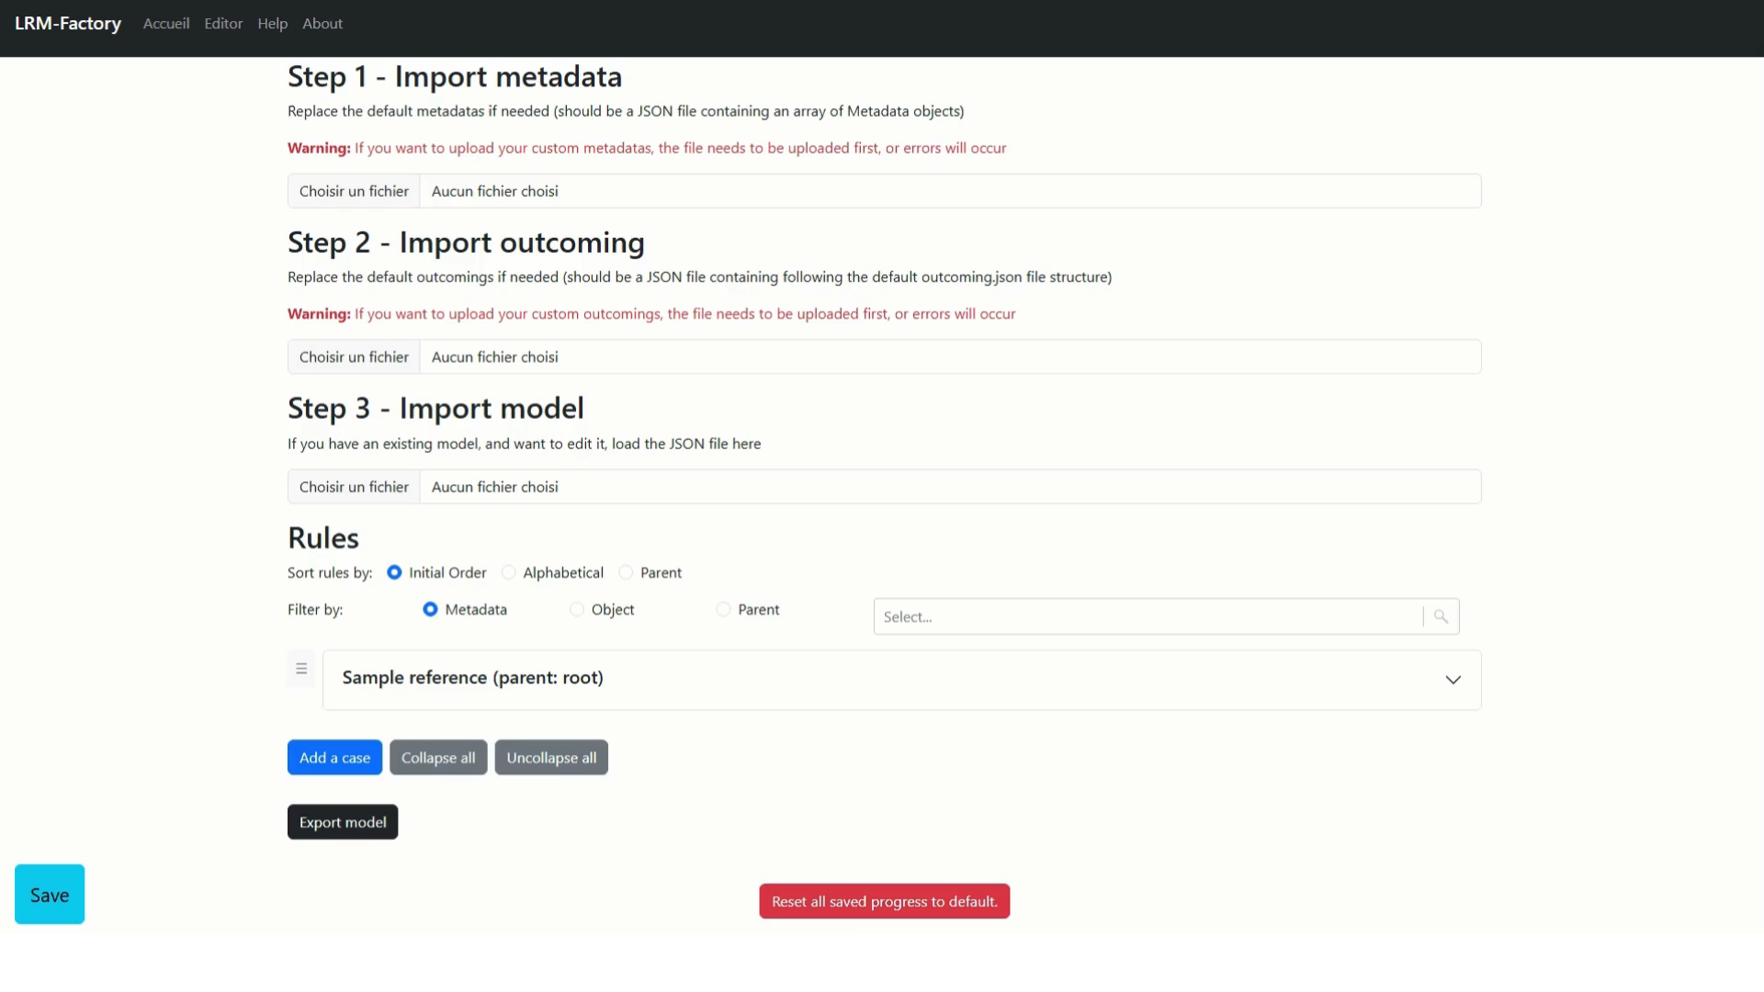
Tool demonstration
CoM3T

Slide 16
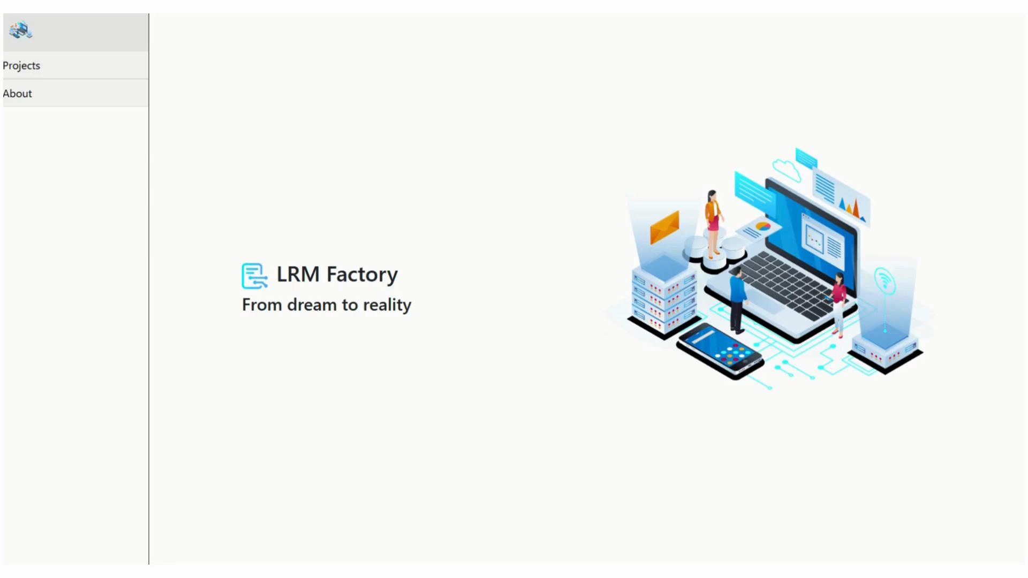
Tool demonstration
Lrm-factory

Slide 17
Future of the project
Notes:
Marie ou Morgane

Slide 18
Future of the project
Complete mapping of Unimarc Relator codes in RDA and almost complete mapping for monographs
Working on serials mapping
Thanks to the possibilities of CoM3T tool : LRM-F on reverse mapping, and on Bibframe conversion
Notes:
Marie ou Morgane / Retours d’expérience dans des revues professionnelles francophones
Communications ou posters en congrès/séminaires/journées d’étude
Publications en revues scientifiques (classées SIGAPS)

Slide 19
Valorisation
Notes:
Marie ou Morgane

Slide 20



Valorisation
participations
6th UNIMARC Users Meeting - UNIMARC in the Metadata Standards Ecosystem - From UNIMARC to RDA: LRM-Factory, an online mass-migration tool
6th UNIMARC USERS MEETING
Bastien, M., Sedoud, M.: Expressing UNIMARC relator codes in RDA. Blog COBISS. (2025).
Bastien, M., Sedoud, m.: 4 ways to lod: analysis of international implementation projects. BIBFRAME worshop in europe. (2025).

Slide 21

Valorisation
github
Work documentation on each mapped fields
Complete unimarc relator codes mapping to rda
Rda records examples in turtle rdf
Methodology documents
www.github.com/lrm-factory

Slide 22


Operation supported by the State as part of the “Digitization of Heritage and Architecture” program of the sector cultural and creative industries (CCI) france 2030, operated by the Caisse des Dépôts.
THANK YOU
Documentation on the project :
www.github.com/lrm-factory
Contacts :
sa.documentationcentrale@chu-lyon.fr
bastien.marie1999@gmail.com
morgane.sedoud@laposte.net

